Slide 2
Beginning Raspberry Pi

Slide 3
Contents
Raspberry Pi
Installing Raspbian
Connecting to Raspbian
Configuring Raspbian
Update Raspbian
VNC
Installing apache web server + PHP

Slide 4
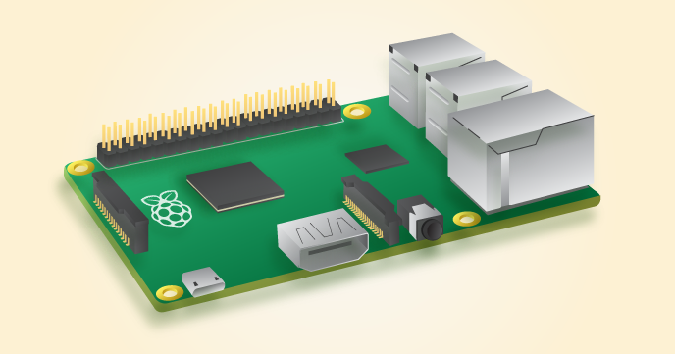
Raspberry Pi
a series of credit card–sized single-board computers
developed in the UK by the Raspberry Pi Foundation
promoting the teaching of basic computer science
Raspberry Pi 3 Spec.
Broadcom BCM2837 SoC
CPU: 1.2GHz quad-core ARM Cortex-A53
1GB RAM
GPU: 400MHz VideoCore IV
4 USB ports, 40 GPIO pins, HDMI, Ethernet, 3.5mm audio jack, Micro SD slot

Slide 5
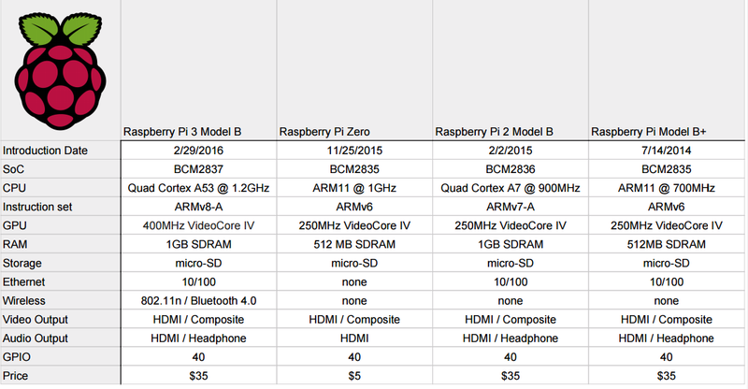
Comparison of RPi Series
Source: http://hackaday.com/2016/02/28/introducing-the-raspberry-pi-3/

Slide 6
Raspberry Pi - OSes
Raspbian – based on Debian
Ubuntu mate
Snappy Ubuntu core
Windows 10 IoT core
OSMC – Open source media center
OpenELEC
Risc OS

Slide 7
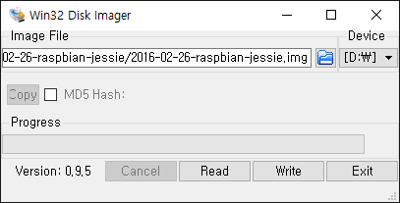
Installing Raspbian
Download the Image of raspbian
https://www.raspberrypi.org/downloads/raspbian/
Writing the Image to the SD card (micro SD card)
In Windows
Win32DiskImager
http://sourceforge.net/projects/win32diskimager/
* If your SD card is not formatted correctly, use SDFormatter https://www.sdcard.org/downloads/formatter_4/
From https://www.raspberrypi.org/documentation/installation/installing-images/README.md

Slide 8
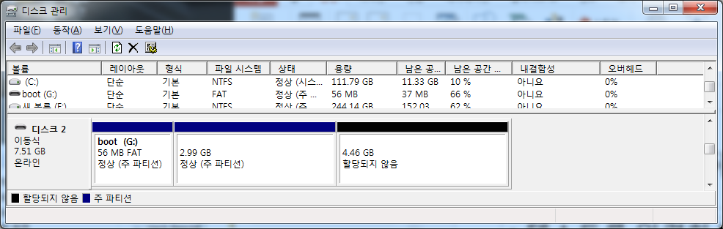
Installing Raspbian
Partition of the SD card
boot: files required to boot the raspbian
Free! You can extend the Raspbian’s partition to this area, or use it for other purposes.
Raspbian image

Slide 9
Enable UART (Serial)
Open boot/config.txt
Add
enable_uart = 1

Slide 10
Connecting to Raspbian
Recommended Tools (for Windows)
Notepad++ (with Hack font (optional)) for Editor
https://notepad-plus-plus.org/
http://sourcefoundry.org/hack/
Putty.exe for SSH client
http://www.chiark.greenend.org.uk/~sgtatham/putty/download.html
TightVNC Viewer for VNC client
http://www.tightvnc.com/
Installation guide: https://www.raspberrypi.org/documentation/remote-access/vnc/windows.md
Insert the SD card to Raspberry Pi 2/3/zero

Slide 11
Connecting to Raspbian
Connecting Raspberry pi to PC through USB2Serial Cable(Adafruit 954)
https://www.adafruit.com/products/954
Cable connection
USB to Serial cable device driver (PL2303)
https://www.adafruit.com/images/product-files/954/PL2303_Prolific_DriverInstaller_v1_12_0.zip
Raspberry pi 2’s GPIO | USB2serial cable
GND | GND (black)
TXD0 | RXD (white)
RXD0 | TXD (green)
5V0 | VCC (red) - optional (power from serial)
More information - http://elinux.org/RPi_Serial_Connection

Slide 12
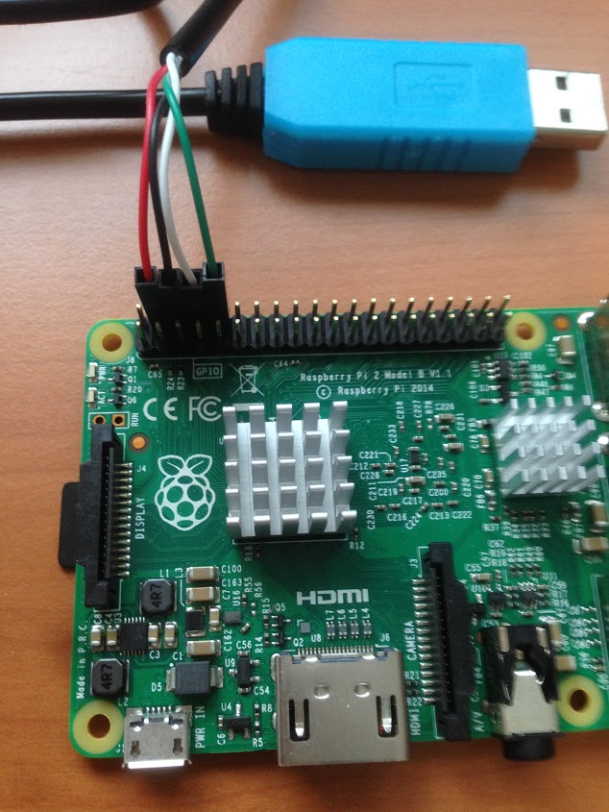
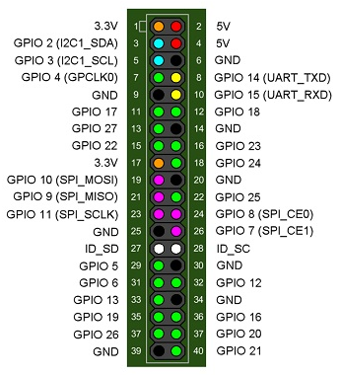
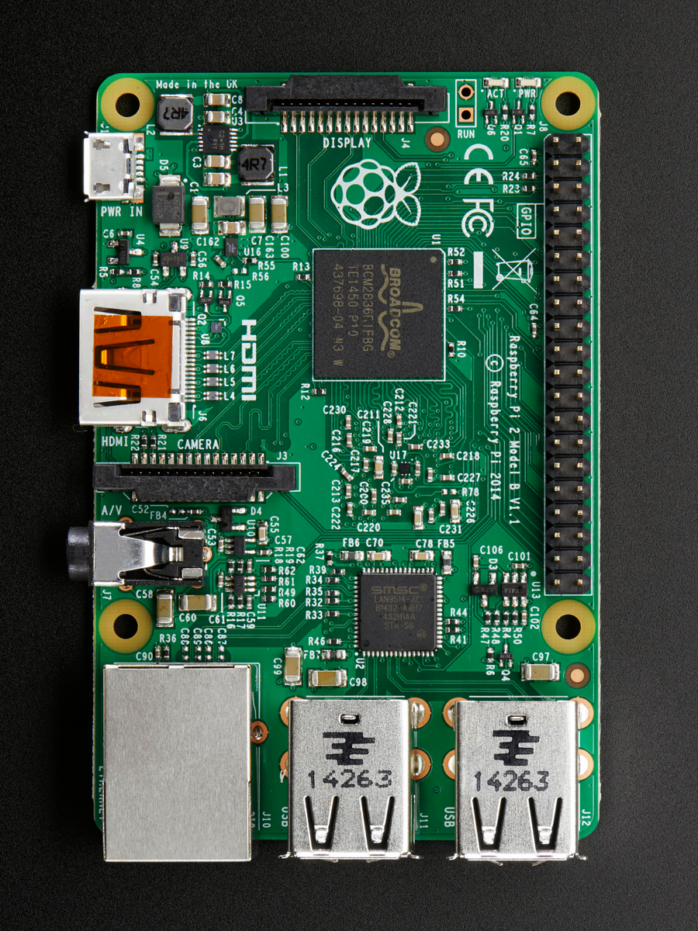
Connecting to Raspbian

Slide 13
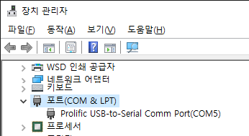
Connecting to Raspbian
Check the PORT number of the cable in device management
Use putty.exe to connect the Raspberry pi via COM port

Slide 14
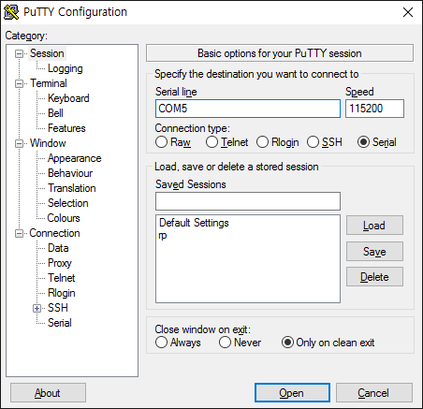
Connecting to Raspbian
putty
Connection type: Serial
Serial Line: COM?
Speed: 115200

Slide 15
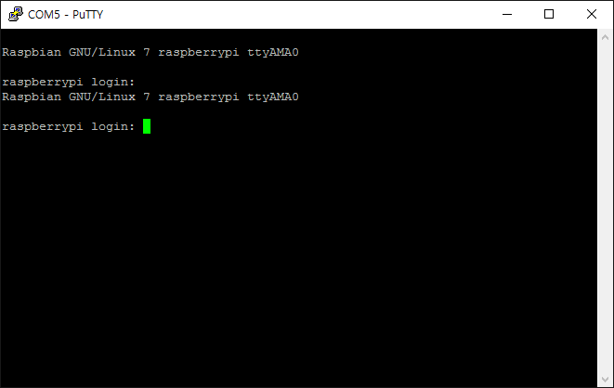
Connecting to Raspbian
ID: pi
Password: raspberry

Slide 16
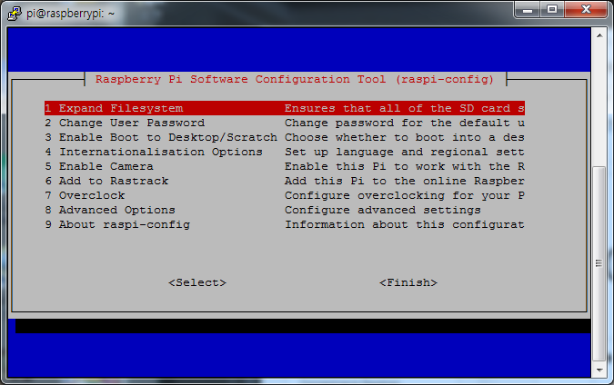
Configuring Raspbian
Raspi-config
$ sudo raspi-config
Expand Filesystem
Use all of the SD card for Raspbian
Check the size of the partition using ‘df’ command
sudo?
Run program with super user’s privileges.

Slide 17
Configuring Raspbian
Wireless configuration
$ sudo nano /etc/wpa_supplicant/wpa_supplicant.conf
$ sudo reboot
ctrl_interface=DIR=/var/run/wpa_supplicant GROUP=netdev
update_config=1
network={
ssid="hswlan"
scan_ssid=1
key_mgmt=WPA-EAP
identity="학번/사번"
password="비밀번호"
}

Slide 18
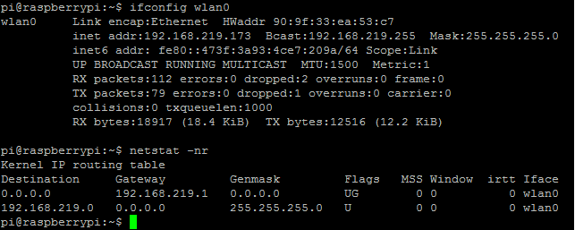
Configuring Raspbian
ifconfig wlan0
netstat -nr

Slide 19
Update Raspbian
$ sudo apt-get update
To update the local package index with the latest changes made in the repositories (/etc/apt/sources.list)
$ sudo apt-get upgrade
Upgrade all installed packages

Slide 20
VNC (Virtual Network Computing)
Graphical desktop sharing system that allows you to remotely control the desktop interface
Install the TightVNC package
$ sudo apt-get install tightvncserver
Rrun TightVNC Server
$ tightvncserver
will prompt you to enter password
Run VNC server
$ vncserver :1 -geometry 1024x768 -depth 24
From https://www.raspberrypi.org/documentation/remote-access/vnc/

Slide 21
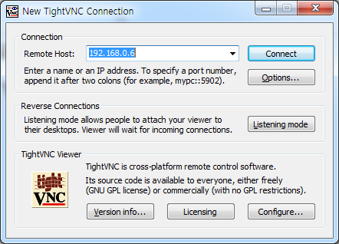
VNC (Virtual Network Computing)
Connecting VNC
Run TightVNC Viewer in your PC (windows)

Slide 22
VNC (Virtual Network Computing)
Listening port 80 (HTTP) only allowed in Our Site.
But, normal pi user cannot listen 80 port.
We need to forward other port to 80 port.
$ sudo iptables -t nat -A PREROUTING -p tcp --dport 80 -j REDIRECT --to 5901
This forward 80 to 5901
Run VNC server
$ vncserver :1 -geometry 1024x768 -depth 24
vncserver will listen at port 5901
if you want to delete the forwarding in the iptable:
$ sudo iptables -t nat -D PREROUTING -p tcp --dport 80 -j REDIRECT --to 5901

Slide 23
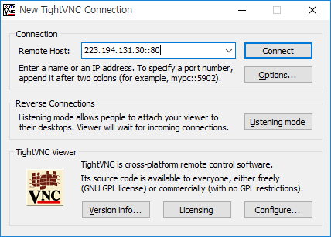
VNC (Virtual Network Computing)
Connect to the port 80 of the raspberry pi
Remote Host: 223.194.131.30::80

Slide 24
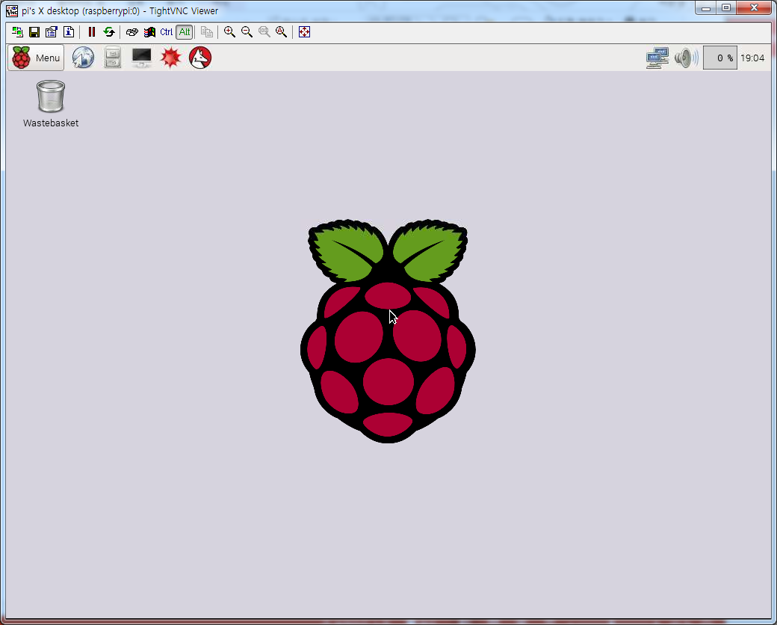
VNC (Virtual Network Computing)

Slide 25
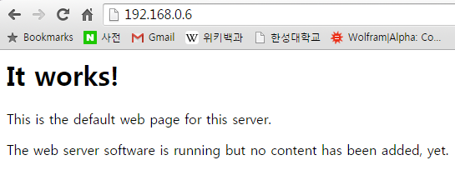
Installing Web Server
$ sudo apt-get install apache2
/var/www/html/index.html
$ sudo nano /var/www/html/index.html
Modify the HTML

Slide 26
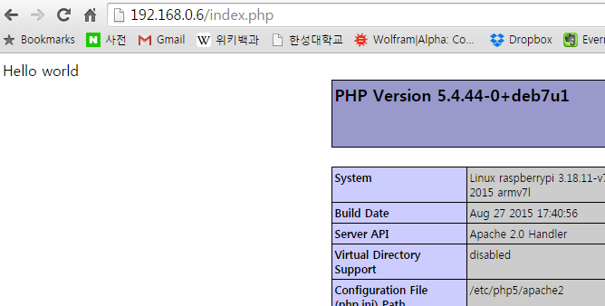
Installing PHP
$ sudo apt-get install php5 libapache2-mod-php5
$ sudo nano /var/www/html/index.php
<?php
echo “Hello world”;
phpinfo();
?>

Slide 27
Q&A

